Slide 1
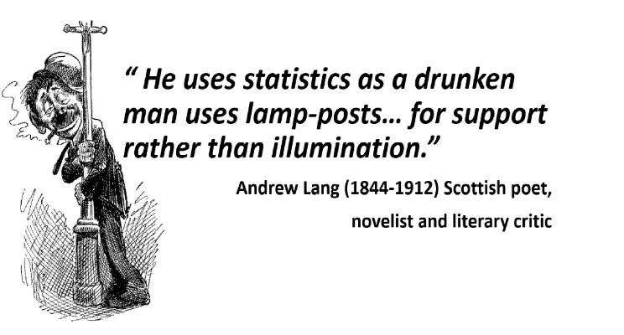
Notes:
Andrew Lang FBA was a Scottish poet, novelist, literary critic, and contributor to the field of anthropology. He is best known as a collector of folk and fairy tales. - Wikipedia

Slide 2
Module 04: EDA – One Numerical Variable

Slide 3
Numerical Variable - Refresher
2 types of variables: categorical variable vs. numerical variable
1) Interval data (STAT) or discrete data (type) (DS) – numeric responses that can only have finite or countably infinite possible values like # of people in a room, # of likes of a YouTube video, # of hair, or even # of grain of sands etc.
2) Ratio data (STAT) or continuous data (type) (DS) – numeric responses that can have infinite possible values like height of human beings, length of petal of irises (iris, a flower), time of an user spent on viewing an IG post, interest earned from a termed deposit etc.
Q: But aren’t height (in metres), length (in centimetres), time (in seconds), and interest (in dollars) all discrete data?
Yes due to convenience (by truncation), and no if there was an instrument that could measure the exact value (in many decimal places) and we care to record them all!

Slide 4
Numerical Variable – Statistics
A statistic is a general term used to describe a number that is calculated or obtained from a sample.
In a given situation, it is sometimes called a measure (STAT; old school), an estimate (STAT), or a metric (DS).
There are 3 areas of statistics for a single numerical variable.
1) Measures or Estimates of the Centre
2) Measures of Estimates of the Location – measuring anything other than the centre
3) Measures or Estimates of the Variability/Dispersion/Spread – measuring how different (or far) individual values are from each other

Slide 5
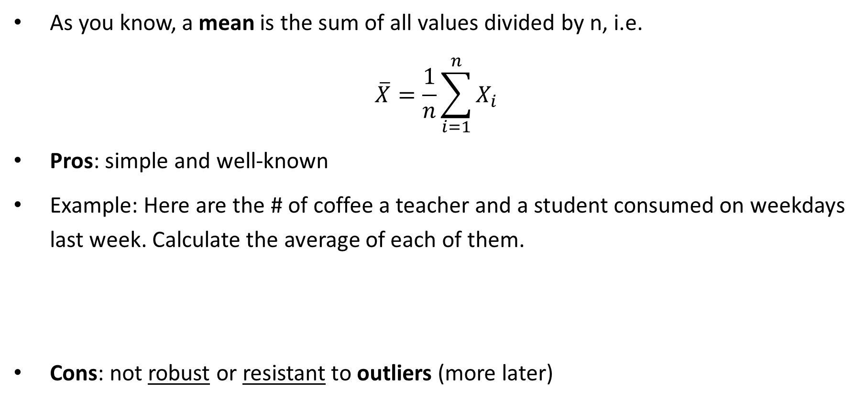
Centre – Mean/Average
As you know, a mean is the sum of all values divided by n, i.e.
$$\overline{X}=\frac{1}{n}\sum_{i=1}^{n}{X_{i}}$$
Pros: simple and well-known
Example: Here are the # of coffee a teacher and a student consumed on weekdays last week. Calculate the average of each of them.
Cons: not robust or resistant to outliers (more later)
Student | 1 | 0 | 1 | 1 | 2
Teacher | 1 | 5 | 1 | 2 | 1
Notes:
Student: mean = (1 + 0 + 1 + 1 + 2)/5 = 5/5 = 1
Teacher: mean = (1 + 5 + 1 + 1 + 2)/5 = 10/5 = 2

Slide 6
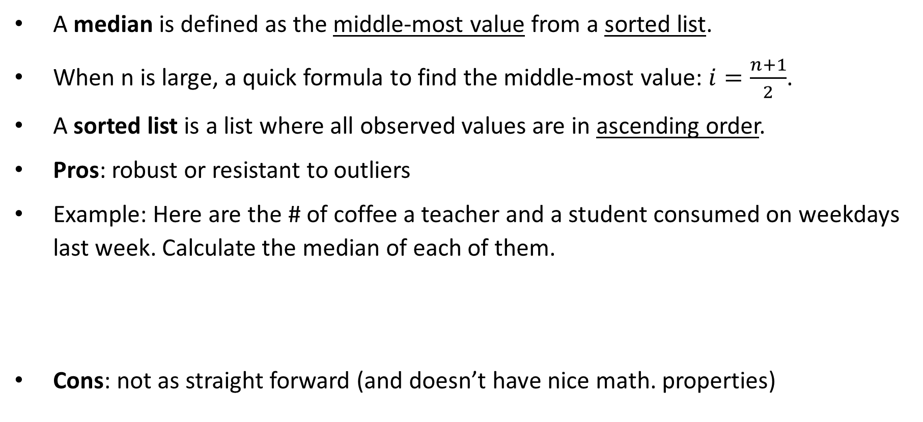
Centre – Median
A median is defined as the middle-most value from a sorted list.
When n is large, a quick formula to find the middle-most value: $i=\frac{n+1}{2}$.
A sorted list is a list where all observed values are in ascending order.
Pros: robust or resistant to outliers
Example: Here are the # of coffee a teacher and a student consumed on weekdays last week. Calculate the median of each of them.
Cons: not as straight forward (and doesn’t have nice math. properties)
Student | 1 | 0 | 1 | 1 | 2
Teacher | 1 | 5 | 1 | 2 | 1
Notes:
Student:
Sorted list: 0, 1, 1, 1, 2 -> median = 1
Teacher:
Sorted list: 1, 1, 1, 2, 5 -> median = 1

Slide 7
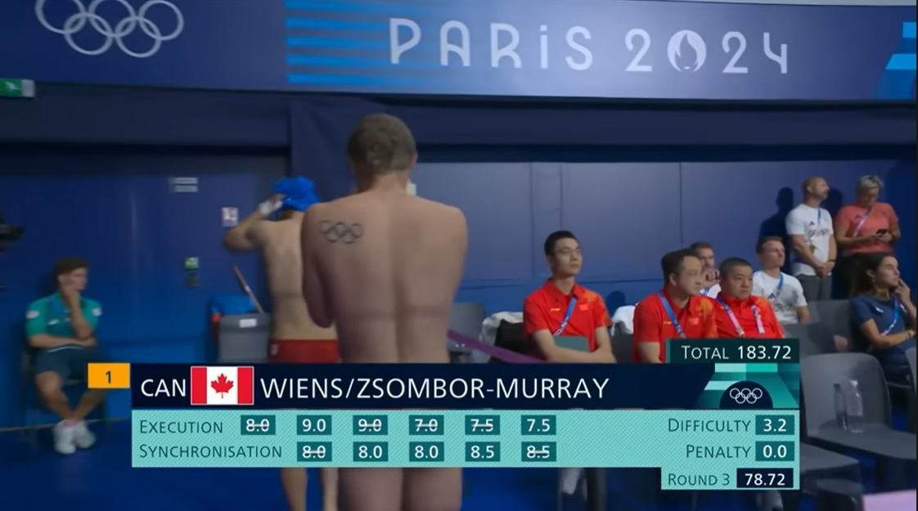
Centre – Trimmed Means
A trimmed mean is a mean with extreme values removed.
Note: extreme values are the largest or smallest values of the sorted list.
The parts that are removed is usually represented in a percentage.
Example: a 10% trimmed mean of a sample (n = 50) is calculated by finding the mean after removing the largest 10% (5 values) and smallest 10% (5 values).
It is widely used in sports events like diving to reduce biases.
Pros: reduce impact of outliers Cons: tedious calc. and nasty math. properties

Slide 8
Centre – Other
A weighted average is an average of observed values that carry non-identical weights.
A weighted median (rarely used) is the median of observed values that carry non-identical weights.
Example: John took four courses last term. Calculate (1) weighted average and (2) weighted median of the GPA.
MLO: Calculate all measures of centre and know their properties.
Grade Point | 2.33 | 3.33 | 4.00 | 3.00
Credits | 4 | 3 | 1 | 2
Weight | 0.4 | 0.3 | 0.1 | 0.2
Notes:
Weighted Average:
Ans = (4*2.33 + 3*3.33 + 1*4.00 + 2*3.00)/(4 +3 + 1 + 2) = 2.931
Weighted Median:
Step 1) Arrange all Grade Point, and keep track of the weight
Grade Point 2.33 3.00 3.33 4.00
Weight 0.4 0.2 0.3 0.1
Step 2) Create a brand new row called “cumulative weight”
Grade Point 2.33 3.00 3.33 4.00
Weight 0.4 0.2 0.3 0.1
Cum. Weight 0.4 0.6 0.9 1.0
Since the GP of 3.00 is in the region of “50% cumulative weight” zone, 3.00 is the weighted median.

Slide 9
Other Measures Needed – Overview
Imagine the following shows five HW marks of two students.
Find the mean and median. Who is a better student?
Q: What does this simple example illustrate?
A: We need something else to differentiate the two students.
Student #1 | 60 | 70 | 80 | 90 | 100
Student #2 | 80 | 80 | 80 | 80 | 80

Slide 10
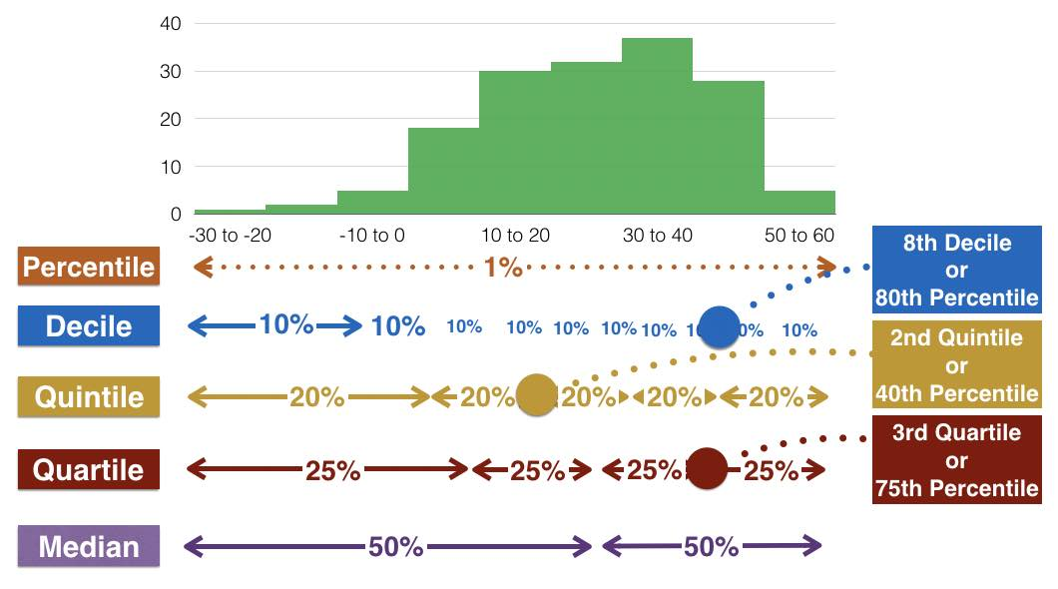
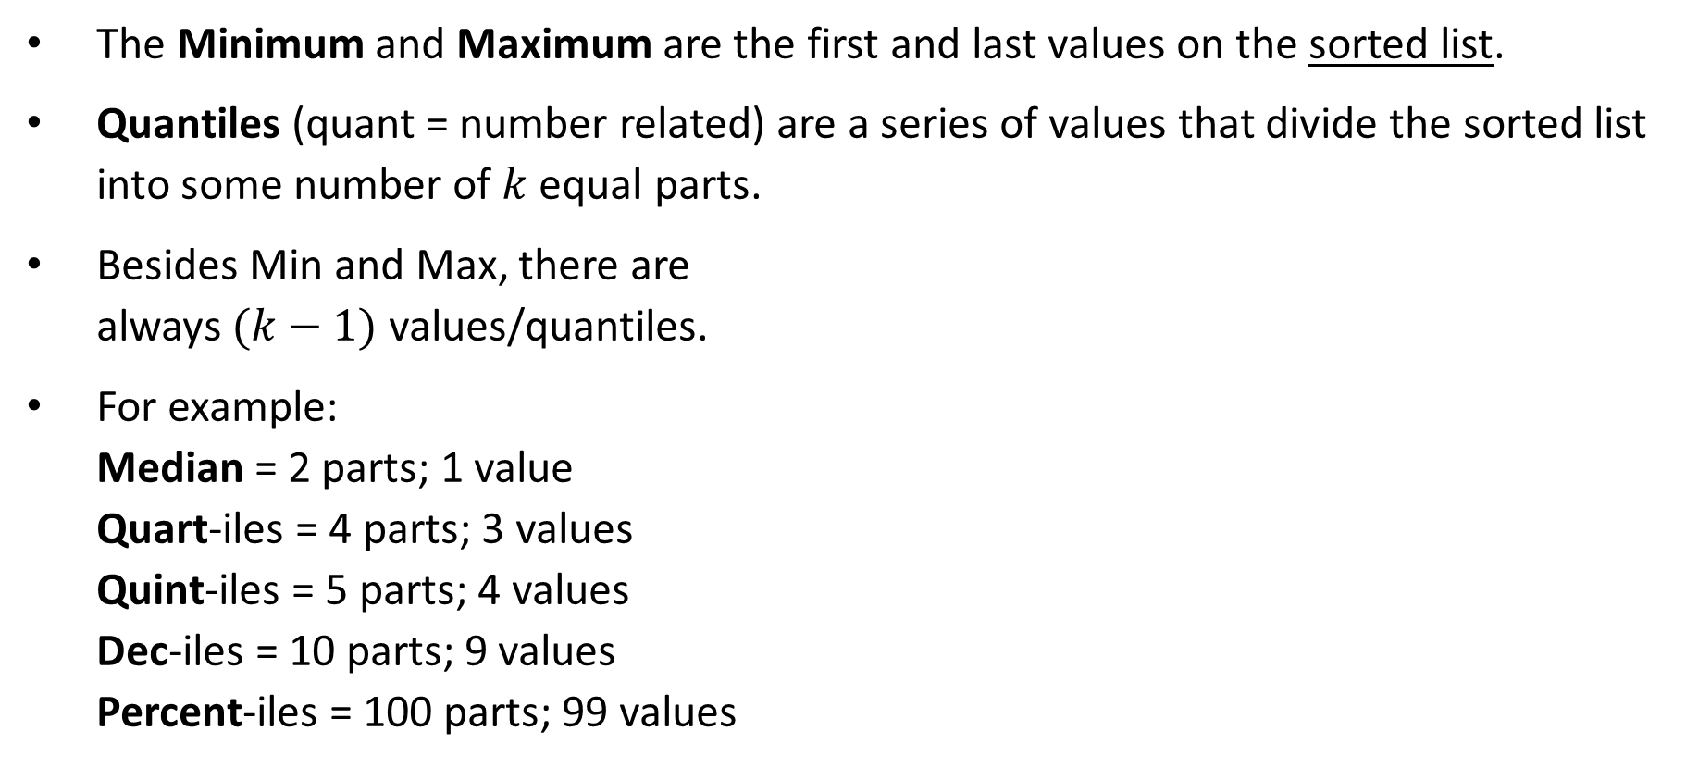
Location – Min/Max and Quantiles
The Minimum and Maximum are the first and last values on the sorted list.
Quantiles (quant = number related) are a series of values that divide the sorted list into some number of $k$ equal parts.
Besides Min and Max, there are always $(k−1)$ values/quantiles.
For example: Median = 2 parts; 1 value Quart-iles = 4 parts; 3 values Quint-iles = 5 parts; 4 values Dec-iles = 10 parts; 9 values Percent-iles = 100 parts; 99 values

Slide 11
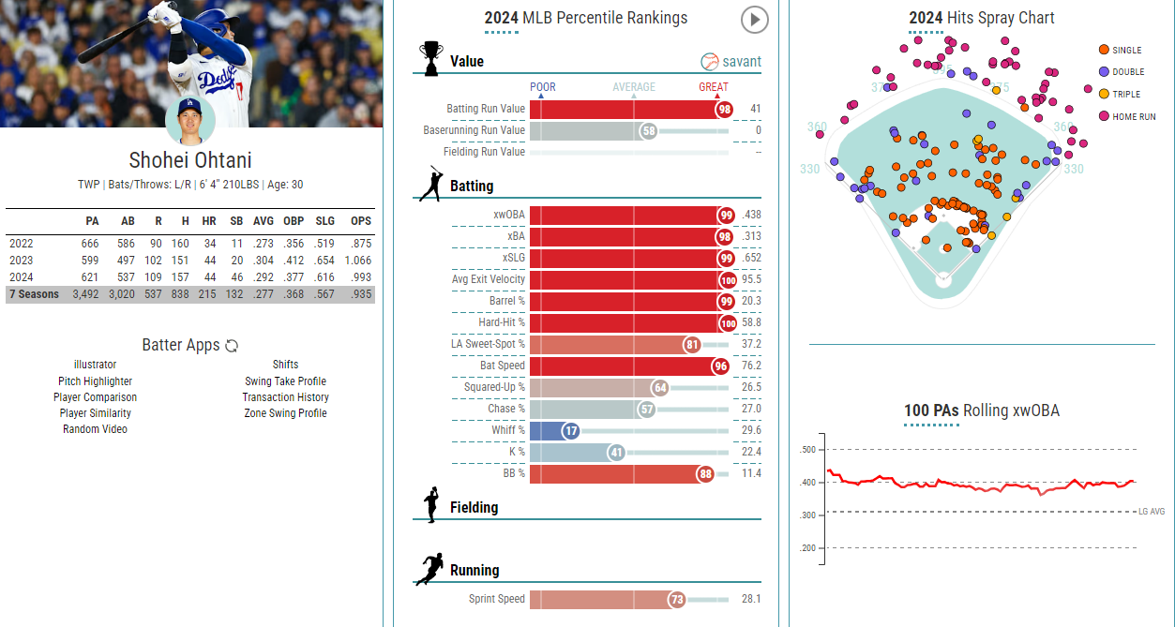
Location – Percentiles
Besides median, percentiles are the most commonly used, especially in sports.
A simple Google search about “Shohei Otani percentile” will give you this.
Notes:
URL: https://baseballsavant.mlb.com/savant-player/shohei-ohtani-660271?stats=statcast-r-hitting-mlb

Slide 12
Location – Quartiles
Among all quantiles, quartiles are used most often in STAT and DS.
Second Quartile (or Q₂): simply the “overall median”.
First Quartile (or Q₁): the median of all observed values strictly smaller than the “overall median”.
Third Quartile (or Q₃): the median of all observed values strictly bigger than the “overall median”.
Example: The number of goals given up by two NHL goalies (A and B) in the past 8 games. Find Q₁ and Q₃.
MLO: Calculate all measures of location and know their properties.
A | 0 | 0 | 1 | 1 | 2 | 3 | 4 | 4
B | 0 | 0 | 1 | 1 | 2 | 3 | 4 | 8
Notes:
Goalie A
Mean = 1.875
Median = 1.5
Q1 = 0.5; Q1 is the median of the sorted list of {0, 0, 1, 1} – to the left of the “overall median” of 1.5.
Q3 = 3.5; Q3 is the median of the sorted list of {2, 3, 4, 4} – to the right of the “overall median” of 1.5.
Goalie B
Mean = 2.375
Median = 1.5
Q1 = 0.5; Q1 is the median of the sorted list of {0, 0, 1, 1} – to the left of the “overall median” of 1.5.
Q3 = 3.5; Q3 is the median of the sorted list of {2, 3, 4, 8} – to the right of the “overall median” of 1.5.

Slide 13
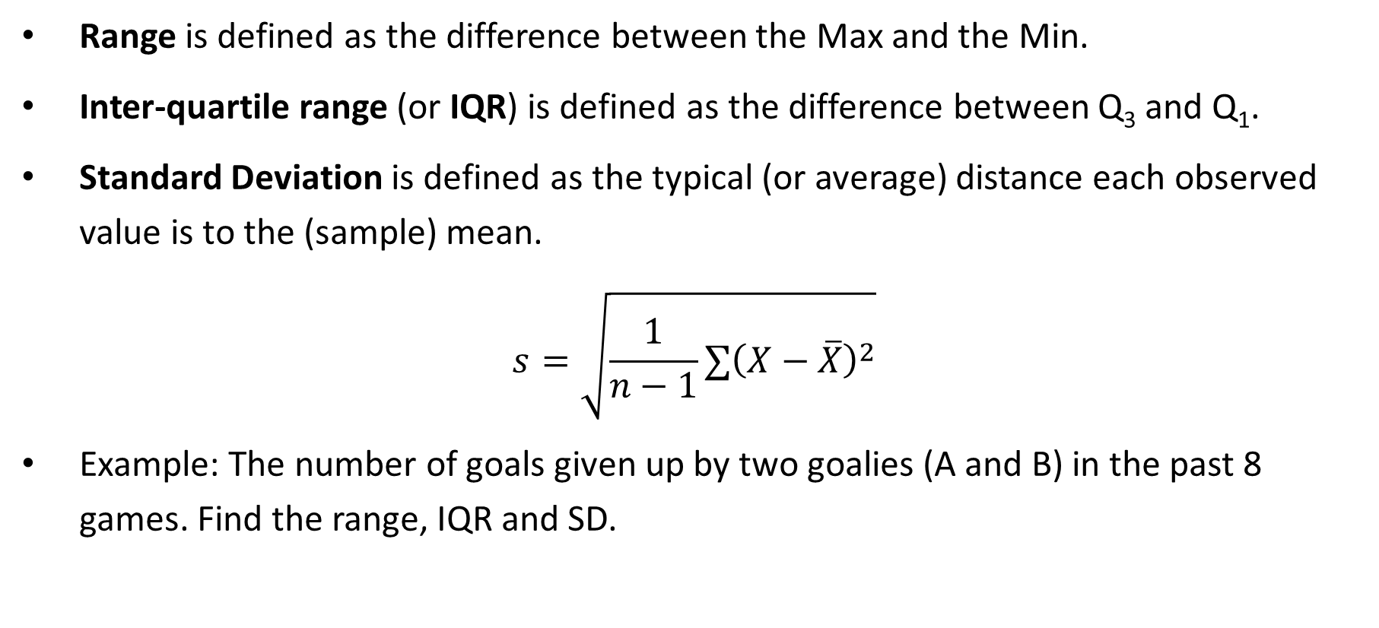
Variability – Range, IQR, SD
Range is defined as the difference between the Max and the Min.
Inter-quartile range (or IQR) is defined as the difference between Q₃ and Q₁.
Standard Deviation is defined as the typical (or average) distance each observed value is to the (sample) mean.
$$s=\sqrt{\frac{1}{n−1}∑{\left(X−\overline{X}\right)}^{2}}$$
Example: The number of goals given up by two goalies (A and B) in the past 8 games. Find the range, IQR and SD.
A | 0 | 0 | 1 | 1 | 2 | 3 | 4 | 4
B | 0 | 0 | 1 | 1 | 2 | 3 | 4 | 8
Notes:
Goalie A
Range = 4 – 0 = 4
IQR = 3.5 – 0.5 = 3
SD = 1.642 (using R)
Goalie B
Range = 4 – 0 = 4
IQR = 3.5 – 0.5 = 3
SD = 2.669 (using R)

Slide 14
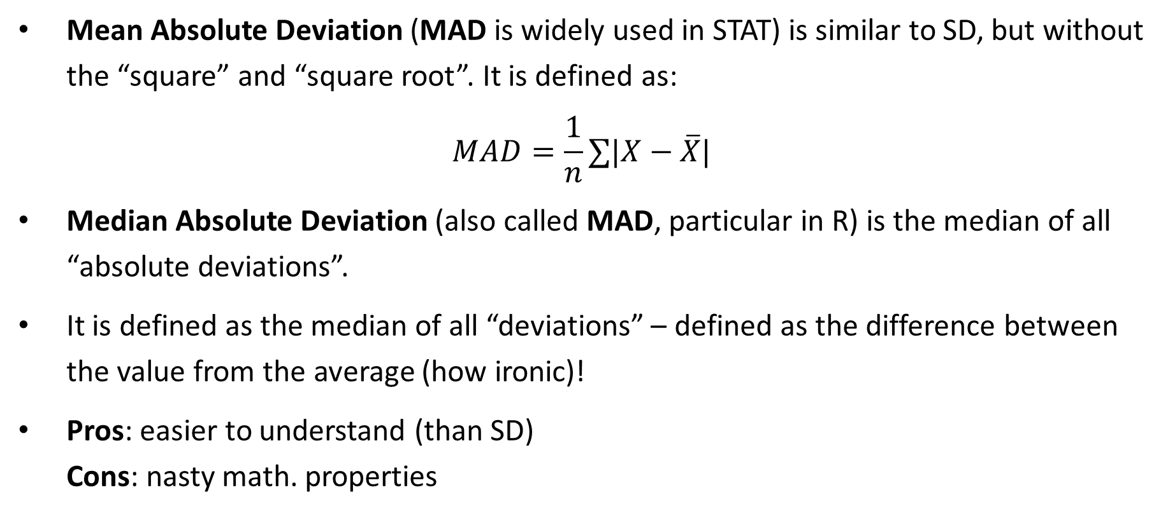
Variability – Notable Mentions
Mean Absolute Deviation (MAD is widely used in STAT) is similar to SD, but without the “square” and “square root”. It is defined as:
$$MAD=\frac{1}{n}∑|X−\overline{X}|$$
Median Absolute Deviation (also called MAD, particular in R) is the median of all “absolute deviations”.
It is defined as the median of all “deviations” – defined as the difference between the value from the average (how ironic)!
Pros: easier to understand (than SD) Cons: nasty math. properties

Slide 15
Statistics - Summary
In general, the very first statistic used to summarize one numerical variable is always a measure of centre – either mean or median.
After measures of centre, we shall need a measure of variability to understand the accuracy (glass half-full) or extent of making error (glass half-empty).
Measures of location is seldomly used on its own.
All measures have two groups – robust vs. not robust to outliers.
 | Not Robust to Outliers | Robust to Outliers
Centre | Mean or Average | Median
Location | Range | Q1 and Q3
Variability | Standard Deviation | IQR

Slide 16
Description of Statistics
The third C is about how we share information with others, in a certain way.
A statistic is defined as 1) a single (summarized) value of 2) the variable of interest from 3) a sample.
Example: Suppose we want to know if the weekly grocery spending of households in the city of Vancouver. A random sample of 500 BC households is drawn. Provide a description of the statistic.
Statistic = the average weekly grocery spending of 500 randomly selected BC households

Slide 17
Description of Parameters
A parameter is defined similarly as 1) a single (summarized) value of 2) the variable of interest from 3) the (target) population.
Example: Suppose we want to know if the weekly grocery spending of households in the city of Vancouver. A random sample of 500 BC households is drawn. Provide a description of the statistic.
Parameter = the average weekly grocery spending of all BC households
(Compare with…) statistic = the average weekly grocery spending of 500 randomly selected BC households

Slide 18
Numerical Graphs
2 basic options: Histograms and Box-and-Whisker Plot (or simply Boxplot)
A typical histogram: - y-axis = percentage or frequency - x-axis = variable of interest
A typical boxplot: - has only one (horizontal) axis = variable of interest - makes use of the 5-number summary
Rule of thumb: histograms are usually used when the sample size is at least 30. Do you know why?

Slide 19
Five-Number Summary & Boxplots
Example: The number of drinks a person had in the past 10 Friday night hangouts.
Find the five-number summary.
Draw a Box-and-Whisker Plot or boxplot. Note: Michael will draw it on the whiteboard. So, come to the class!
0 | 1 | 1 | 2 | 2 | 2 | 3 | 3 | 4 | 8
Min. | Q₁ | Median | Q₃ | Max.
Notes:
To draw a horizontal boxplot:
Draw the x-axis, label it with variable of interest, and put down a proper scale of the axis.
Draw two short vertical lines for Q1 and Q3 at their corresponding points, above the x-axis.
Connect the two lines to form a box.
Draw another vertical line for median inside the box in (3).
Draw the right-hand whisker from Q3 to the maximum.
Draw the left-hand whisker from Q1 to the minimum.

Slide 20
Description of Numerical Graphs - 1
There are four main areas we want to focus on from a histogram or a boxplot.
1) Centre To “guestimate” a value (or a range of values) to represent the centre
2) Spread (or variability) To “guestimate” a value (or a range of values) to represent the spread
3) Outliers (visually) To determine visually if there is/are outlier(s)
4) Shape To describe the shape using one of the three descriptors. A) Symmetrical, b) Right-skewed (or positively-skewed), or c) Left-skewed (or negatively-skewed)

Slide 21
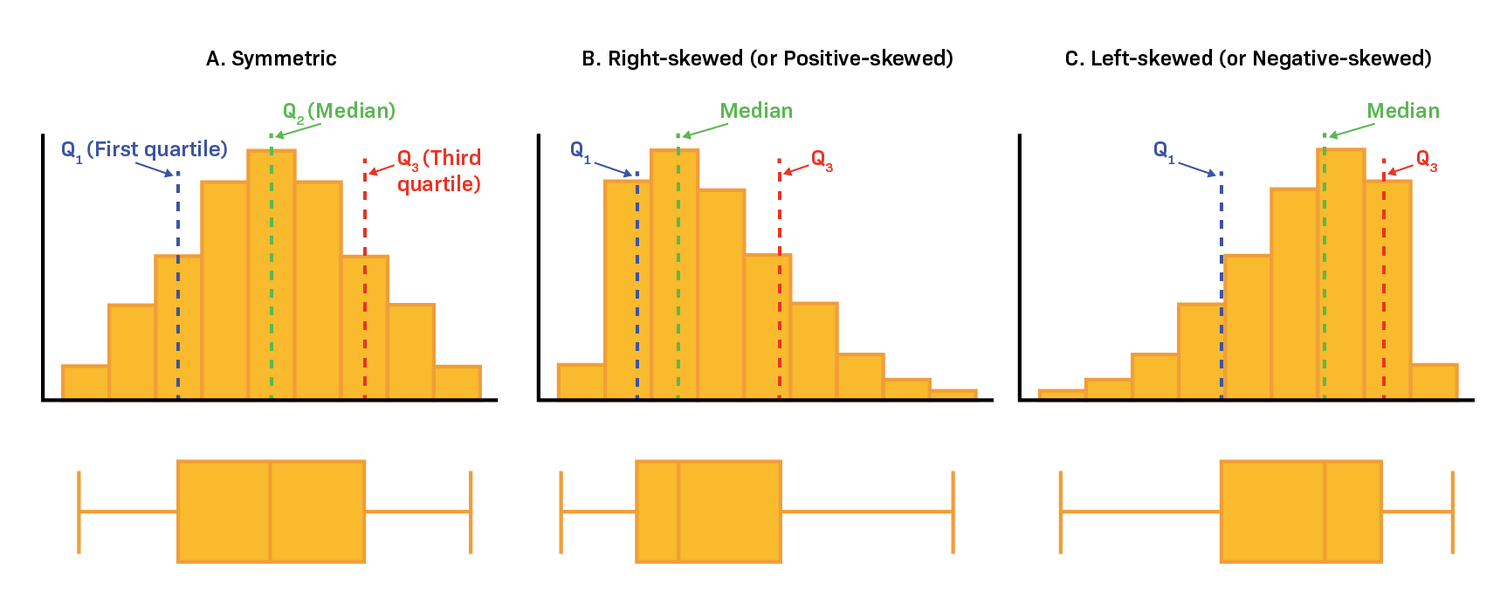
Description of Numerical Graphs - 2
Note: The descriptions are rather subjective.
Here is how skewness looks like in both graphs.

Slide 22
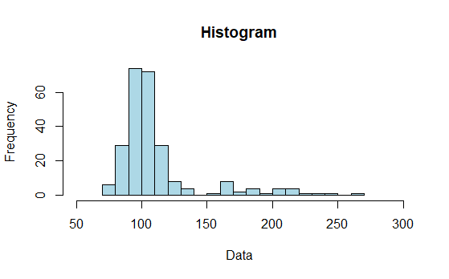
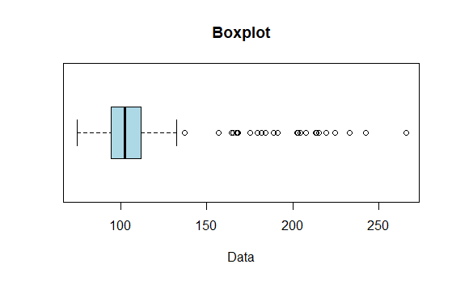
Examples
Provide the description of the following graphs.

Slide 23
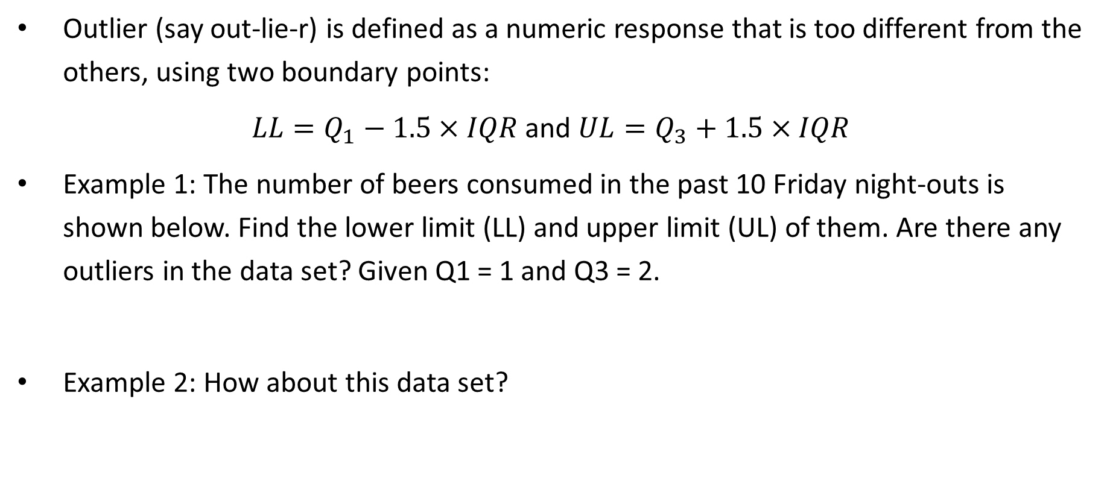
Determining Outliers – Using IQR
Outlier (say out-lie-r) is defined as a numeric response that is too different from the others, using two boundary points:
$LL=Q_{1}−1.5×IQR$ and $UL=Q_{3}+1.5×IQR$
Example 1: The number of beers consumed in the past 10 Friday night-outs is shown below. Find the lower limit (LL) and upper limit (UL) of them. Are there any outliers in the data set? Given Q1 = 1 and Q3 = 2.
Example 2: How about this data set?
0 | 1 | 1 | 2 | 3 | 1 | 2 | 1 | 1 | 1
0 | 1 | 1 | 2 | 5 | 1 | 2 | 1 | 1 | 1

Slide 24
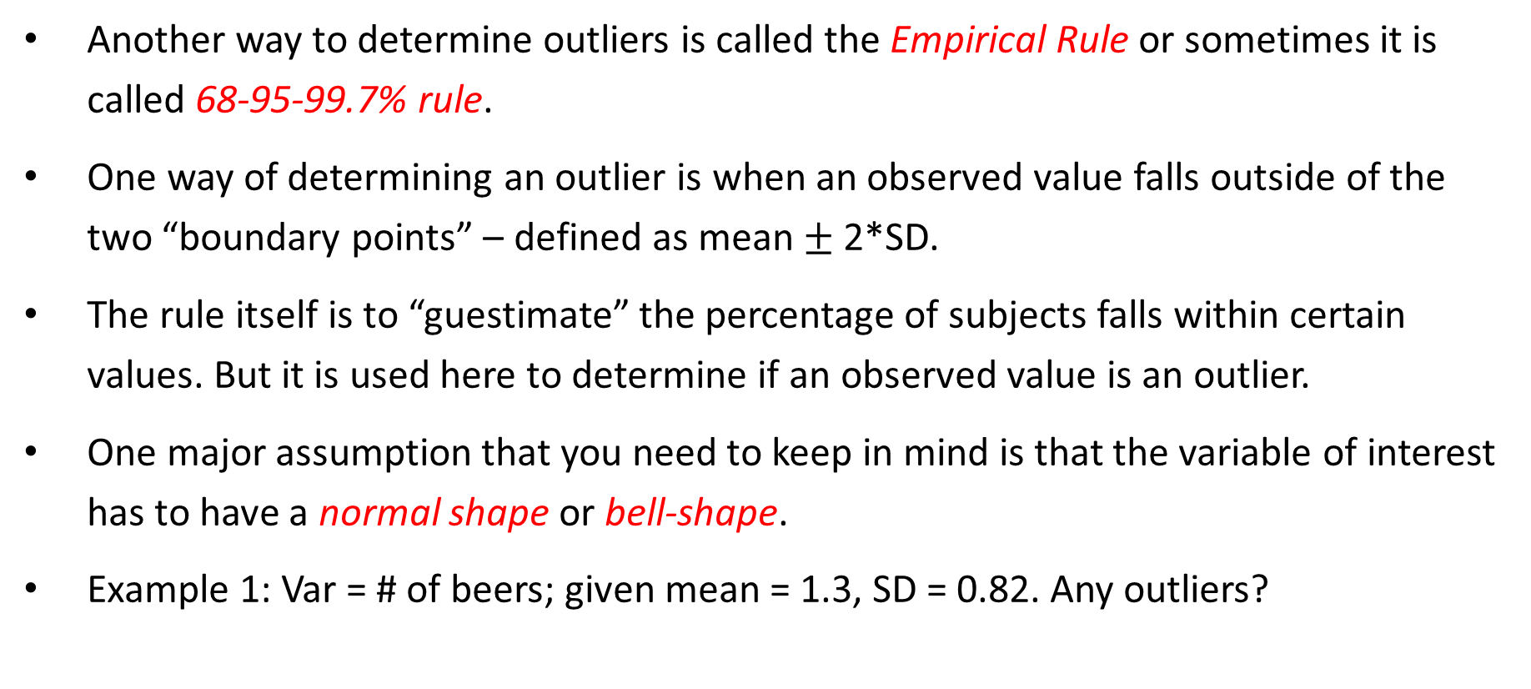
Determining Outliers – Using SD
Another way to determine outliers is called the Empirical Rule or sometimes it is called 68-95-99.7% rule.
One way of determining an outlier is when an observed value falls outside of the two “boundary points” – defined as mean $±$ 2*SD.
The rule itself is to “guestimate” the percentage of subjects falls within certain values. But it is used here to determine if an observed value is an outlier.
One major assumption that you need to keep in mind is that the variable of interest has to have a normal shape or bell-shape.
Example 1: Var = # of beers; given mean = 1.3, SD = 0.82. Any outliers?
0 | 1 | 1 | 2 | 3 | 1 | 2 | 1 | 1 | 1

Slide 25
Summary
We learned how some statistics are more prone to the impact of outliers (or less resistant to outliers), e.g. mean and standard deviation.
And some statistics are more resistant to outliers, e.g. median and IQR.
The million-dollar question is always: shall we use mean/SD or median/IQR as the main set of statistics in data summary?
Now, we have learned some powerful tools to identify outliers.
Summary:
When… | there are outliers or data is skewed | there are no obvious outliers or data is pretty symmetrical
Use… | Median & IQR | Mean & SD

Slide 26
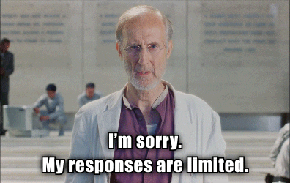
Any Questions?

